Slide 1
Development of Barrier Bucket RF Systems for ESR and SIS100
M. Frey, 14. June 2018

Slide 2
outline
motivation/history at ESR
ESR BB system
requirements
theory of operation
choice of ring core material
ESR BB cavity design
prototype ring core impedance measurement+modeling
PSpice simulation of full cavity
ESR BB cavity properties
ESR BB pre-distortion
ESR BB signal generation
ESR BB full system results
ESR BB outlook
SIS100 BB system

Slide 3
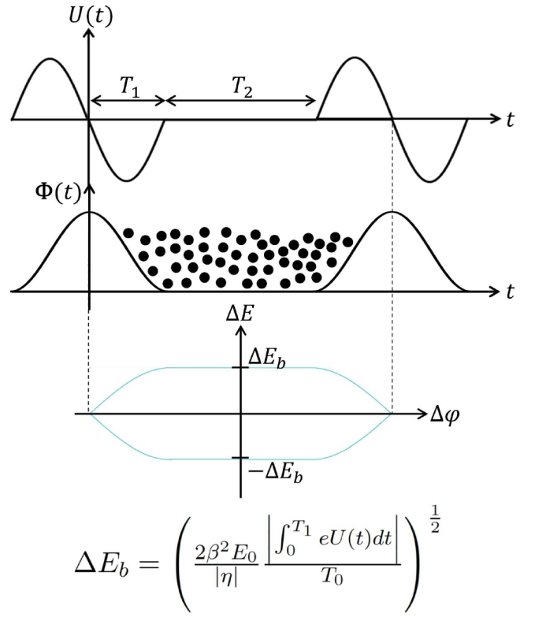
motivation
RF pulses create potential barriers
barrier creation allows longitudinal beam manipulation, e.g. confinement of a bunch
when barriers are moved, beams can be compressed -> intensity increases
multiple injections between compression operations lead to further intensity increase („longitudinal stacking“)
voltage
potential
bucket
bucket height
J. Harzheim, Temf, TU Darmstadt

Slide 4
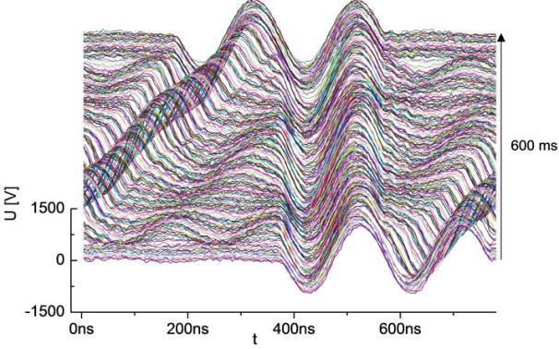
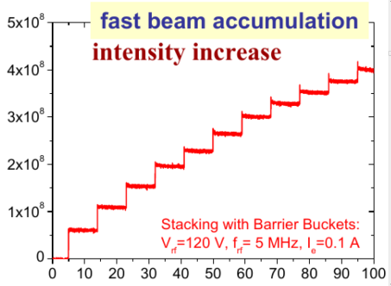
demonstration at ESR
ferrite acceleration cavities were used with single sine + offset pulses
gap voltage
beam signal
G. Schreiber, LRF department, GSI
C. Dimopoulou, BCO department, GSI
hardly feasible due to extreme sensitivity concerning pulse parameters
development of a specialized BB cavity

Slide 5
outline
motivation/history at ESR
ESR BB system
requirements
theory of operation
choice of ring core material
ESR BB cavity design
prototype ring core impedance measurement+modeling
PSpice simulation of full cavity
ESR BB cavity properties
ESR BB pre-distortion
ESR BB signal generation
ESR BB full system results
ESR BB outlook
SIS100 BB system

Slide 6
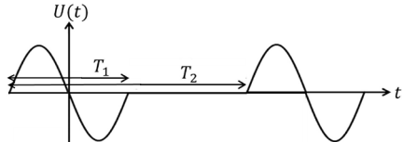
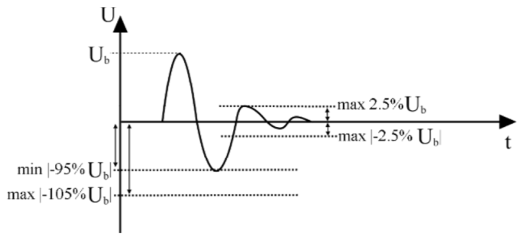
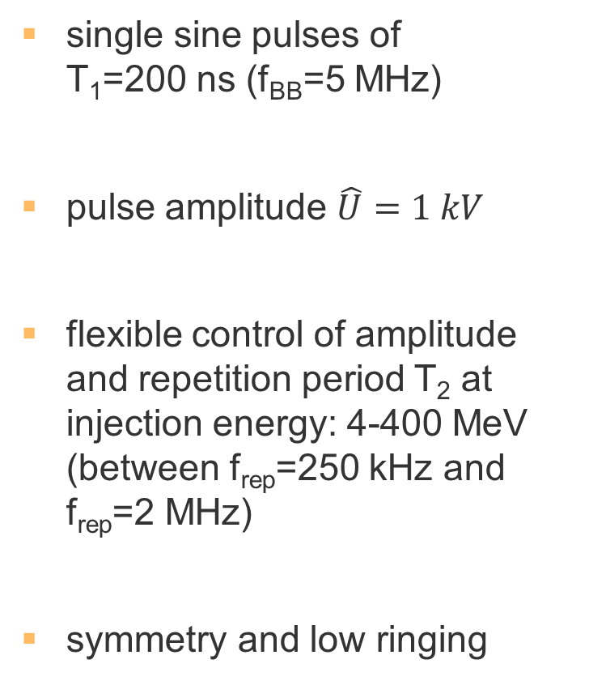
ESR requirements
single sine pulses of T₁=200 ns (f_{BB}=5 MHz)
pulse amplitude $\hat{U}=1 kV$
flexible control of amplitude and repetition period T₂ at injection energy: 4-400 MeV (between f_{rep}=250 kHz and f_{rep}=2 MHz)
symmetry and low ringing

Slide 7
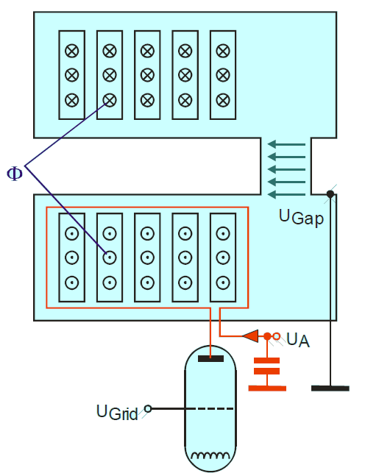
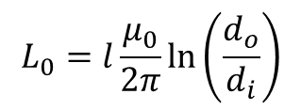
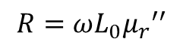
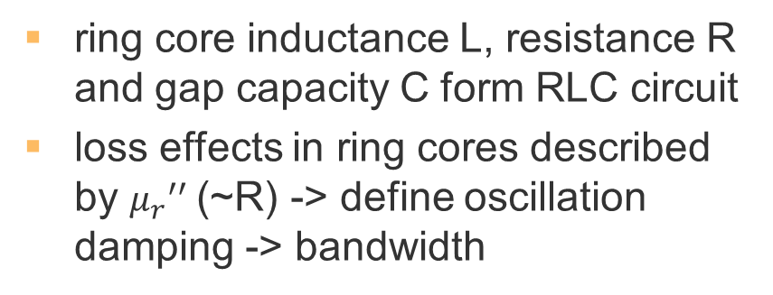
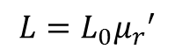
ESR cavity design – theory of operation
cavities with ring cores are transformers: ring core = iron core, housing = secondary winding, gap capacity = load
ring cores are a lossy inductance defined by geometry and complex µ_{r}
$$L_{0}=l\frac{μ_{0}}{2π}ln\left(\frac{d_{o}}{d_{i}}\right)$$
$$L=L_{0}{μ_{r}}^{′}$$
$$R=ωL_{0}{μ_{r}}^{′′}$$
ring core inductance L, resistance R and gap capacity C form RLC circuit
loss effects in ring cores described by ${μ_{r}}^{′′}$(~R) -> define oscillation damping -> bandwidth
H. Klingbeil, Temf, TU Darmstadt

Slide 8
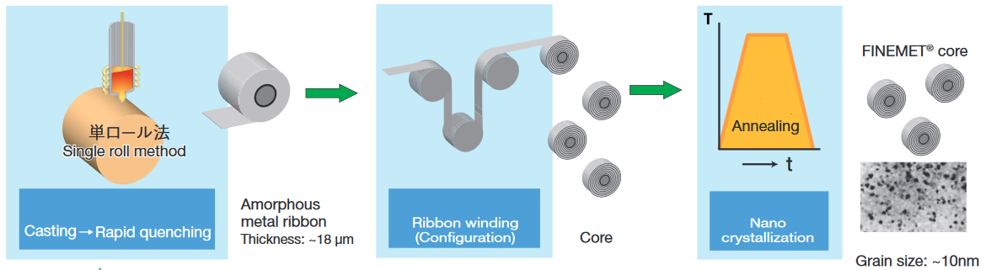
ESR cavity design – ring core material
ferrites: high Q-value -> narrowband cavities ☹
iron-based nanocrystalline Magnetic Alloy (MA) ring cores: very low Q-value -> broadband cavities ☺
Hitachi Metals Ltd.
cores are wound from thin ribbon: side surfaces are roughly textured because layers tend to misalign (important for cooling)

Slide 9
outline
motivation/history at ESR
ESR BB system
requirements
theory of operation
choice of ring core material
ESR BB cavity design
prototype ring core impedance measurement+modeling
PSpice simulation of full cavity
ESR BB cavity properties
ESR BB pre-distortion
ESR BB signal generation
ESR BB full system results
ESR BB outlook
SIS100 BB system
strategy: ring cores dominate cavity –> analyse prototype core to enable simulation of full cavity -> obtain amplifiers load impedance

Slide 10
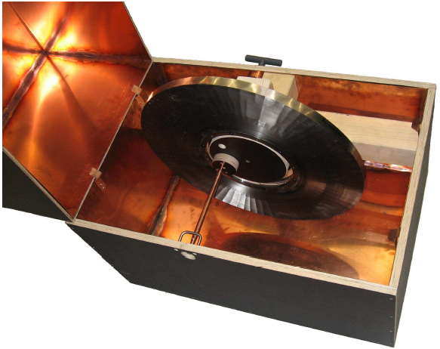
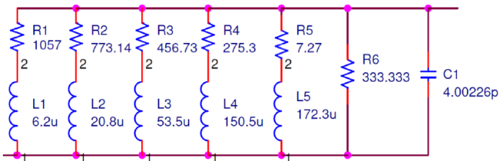
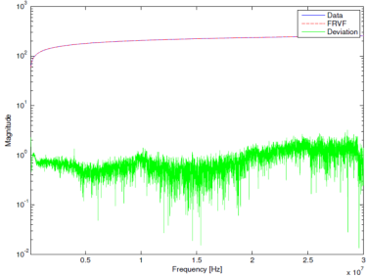
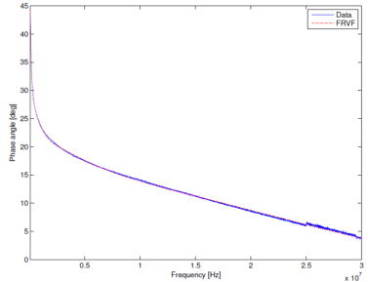
ESR cavity design – impedance measurement and PSpice modeling
identification of lumped-element equivalent circuit using „vector-fitting“ algorithm
P. Hülsmann, RRF department, GSI
impedance measurement of prototype core in test box
subtraction of test box influence (estimated with CST simulation)
J. Harzheim, H. Klingbeil, Temf, TU Darmstadt
1 ring core at 5 MHz: |Z|≈200 Ω

Slide 11
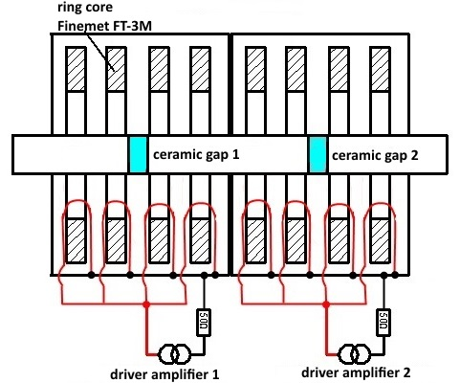
ESR cavity idea
4 ring cores connected in parallel
-> gap voltage = 4 x voltage at load
one cavity per pulse (2 in same housing)
P. Hülsmann, RRF department, GSI

Slide 12
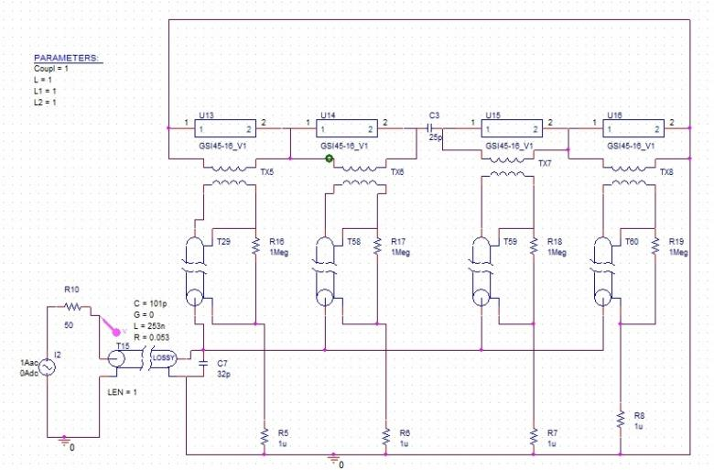
ESR simulation of full cavity
cavity
1 m cable
coupling loops
J. Harzheim, H. Klingbeil, Temf, TU Darmstadt
sufficient matching between amplifier and cavity at 5 MHz
at 5 MHz and |Z|=25 Ω, U=4x225 V =900 V possible with 1 kW
satisfying results
production approval

Slide 13
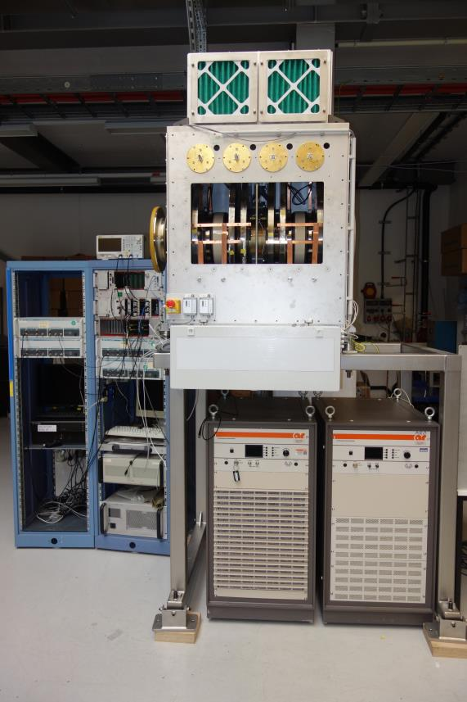
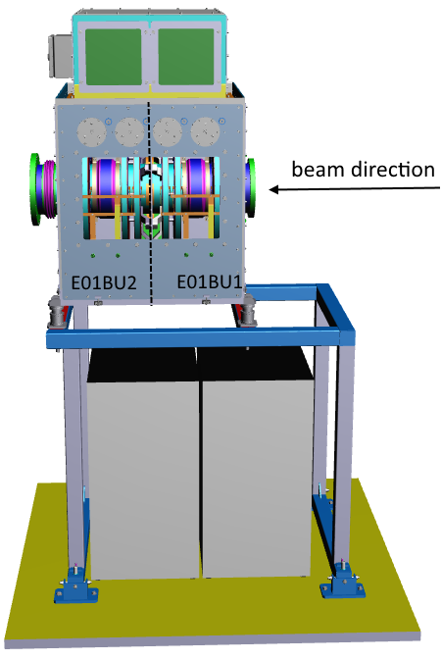
ESR cavity design – CAD and production
based on extensive testing with ARD broadband test cavity
very short beam pipe requested (for Schottky pick-up on same base-frame)
large ESR beam pipe diameter -> little space for ring core material
power range of amplifiers 1 kW -> air cooling necessary
air cooling
amplifiers
unspectacular but huge milestone!
C. Christoph, RRF department, GSI

Slide 14
outline
motivation/history at ESR
ESR BB system
requirements
theory of operation
choice of ring core material
ESR BB cavity design
prototype ring core impedance measurement+modeling
PSpice simulation of full cavity
ESR BB cavity properties
ESR BB pre-distortion
ESR BB signal generation
ESR BB full system results
ESR BB outlook
SIS100 BB system

Slide 15
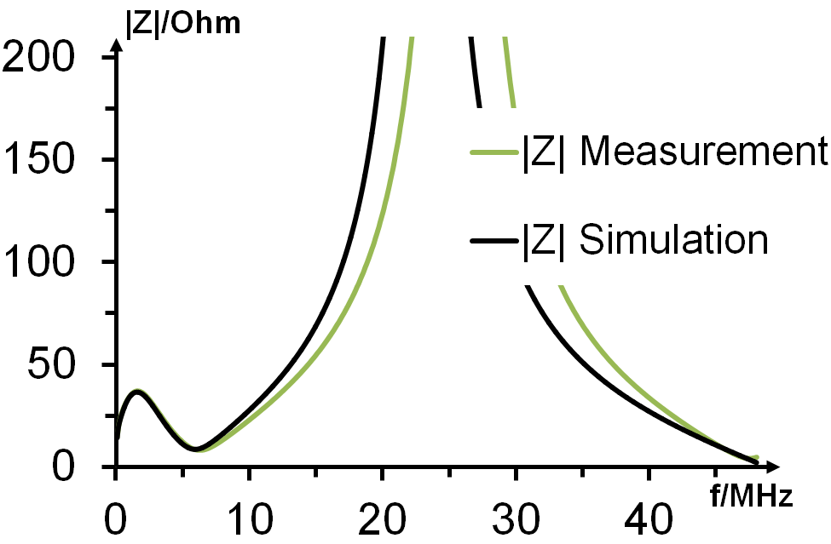
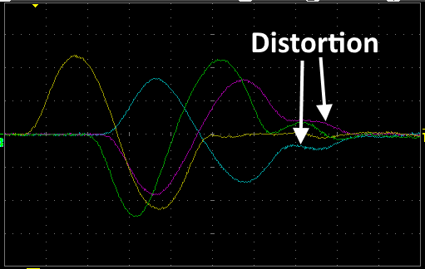
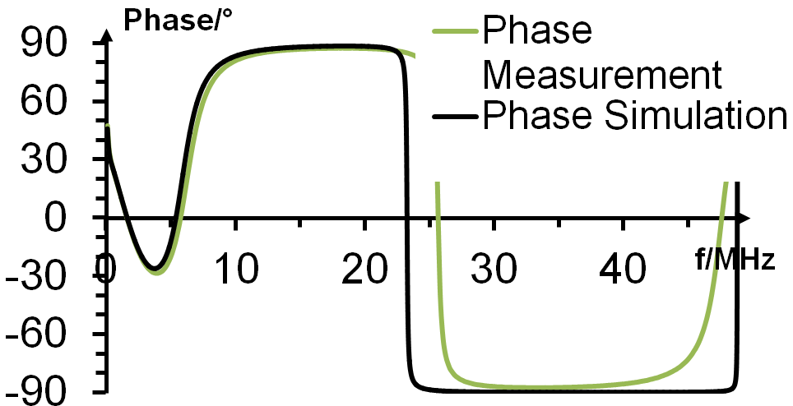
ESR cavity properties
measurement result:
frequency response results in distortion of input voltage
pre-distortion of signals is necessary
simulation without gap voltage divider

Slide 16
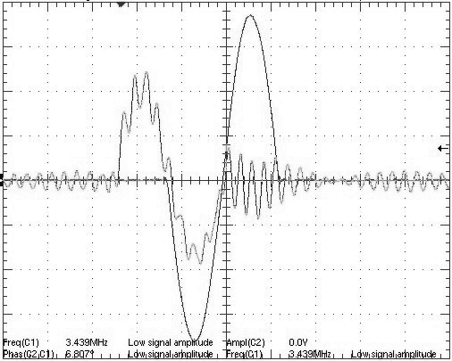
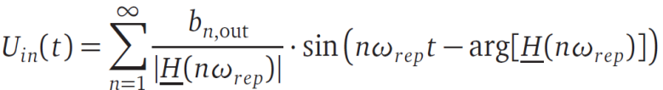
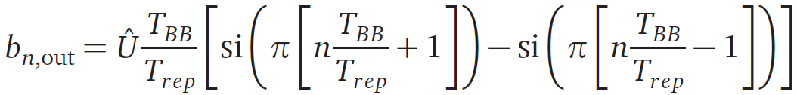
LLRF - pre-distortion of signals
1. measure transfer function H
2. calculate Fourier-coefficients of pre-distorted signal
3. transformation to time-domain + application
gap voltage accuracy depends on system bandwith (=number of transmittable b_{n})
linear, time-invariant system, periodic signal
periodic signal -> one cavity per pulse for moving barriers
single-sine signal

Slide 17
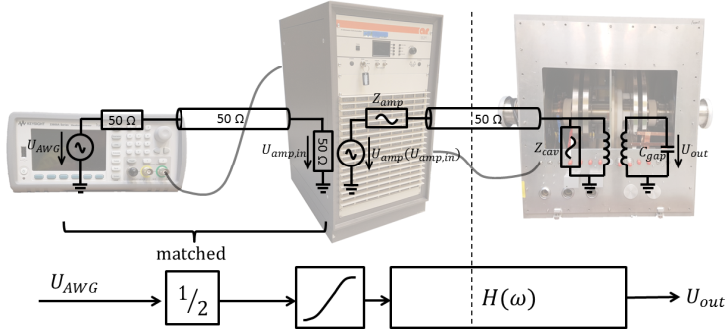
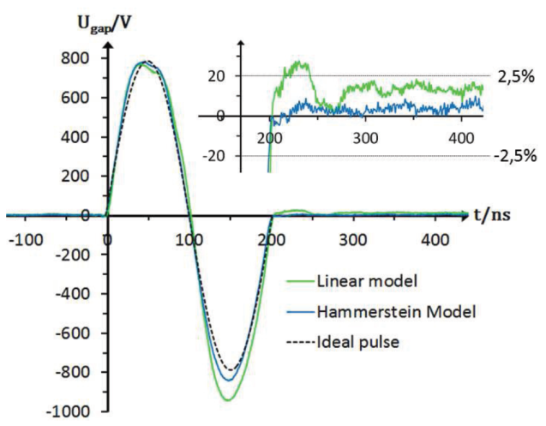
LLRF - non-linear predistortion
problem with linear pre-distortion: amplifier characteristic
J. Harzheim, H. Klingbeil, Temf, TU Darmstadt
a) Nonlinearity is modeled by a static nonlinearity at the amplifier input, while the rest of the system is modeled linear (Hammerstein model)
b) Optimization (iterative) of input signal for specific working point
no datasheet value depicts this characteristic -> amplifier selection by testing

Slide 18
outline
motivation/history at ESR
ESR BB system
requirements
theory of operation
choice of ring core material
ESR BB cavity design
prototype ring core impedance measurement+modeling
PSpice simulation of full cavity
ESR BB cavity properties
ESR BB pre-distortion
ESR BB signal generation
ESR BB full system results
ESR BB outlook
SIS100 BB system

Slide 19
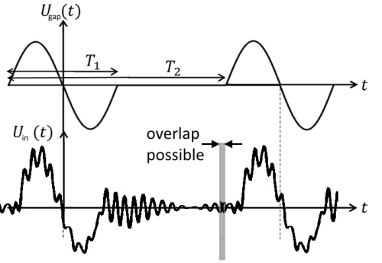
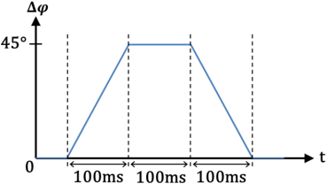
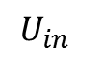
LLRF – re-triggering
when barriers are moved, consecutive pre-distorted waveforms may overlap
produce alternating trigger pulses
playback of every 2nd waveform
DDS
(h=1)
TRG
RD
Tabor AWG
signal combination
$$U_{in}$$
Tabor AWG
DAC
RAMP
CONV.
signal generation must detect new trigger while output still active
-> 2 alternating signal generators
SCU
PC
K. Groß, H. Klingbeil, Temf, TU Darmstadt

Slide 20
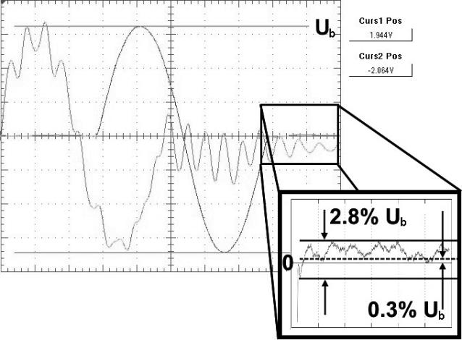
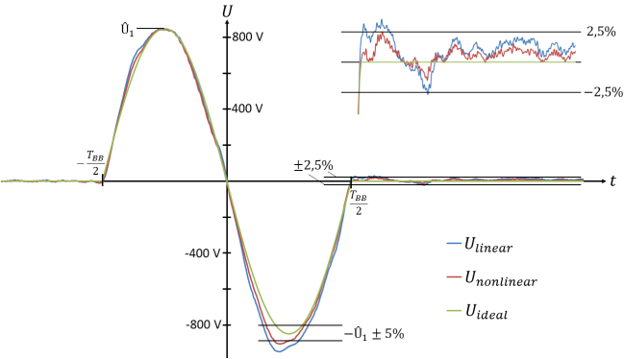
ESR BB system – full system results I
linear pre-distortion:
U_{b}=520 V
good quality
non-linear pre-distortion:
U_{b}=800 V
improvement in ringing after pulse
symmetry insufficient (internal amplifier limitation?)
J. Harzheim, Temf, TU Darmstadt

Slide 21
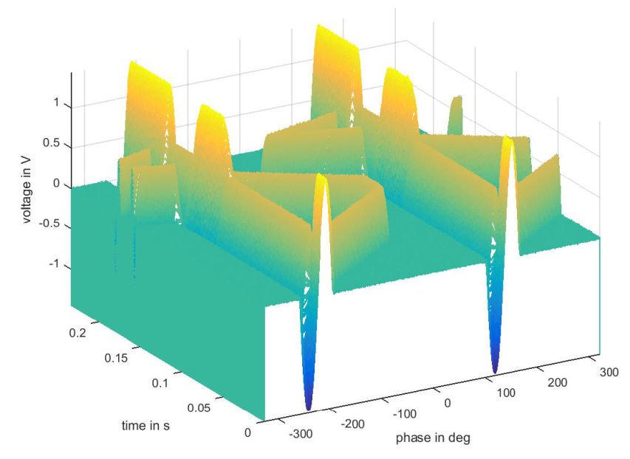
ESR BB system – full system results II
phase shifting of moving barriers demonstrated with full system (manual data supply from PC to SCU)
two revolution periods are shown
here barriers are created at equal phase angle (amplitude doubles)
one barrier is shifted by 180° in both directions
full system works as intended! -> installation appproval
K. Groß, Temf, TU Darmstadt

Slide 22
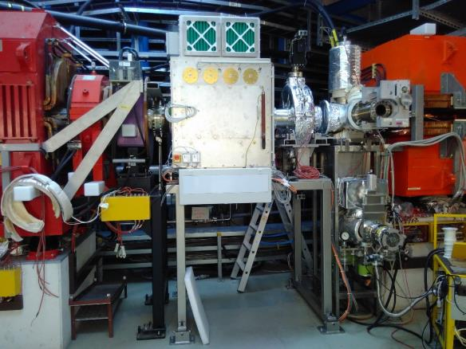
ESR BB system – status + outlook
status:
function of full system demonstrated
pulse amplitude U_{b}=520 V with high quality achieved (1 kW amplifier)
installation in ESR finished
to do:
software development for unit controller (task: e.g. calculation of pre-distorted waveforms, control of signal generators)
adaption of control system connection (e.g. phase ramp in FESA-class for ramped-devices?)

Slide 23
outline
procurement starts 2019
ESR BB system
SIS100 BB system: pre-development phase
requirements
SIS100 BB cavity design
oil cooling
SIS100 BB power amplifier design
SIS100 BB simulation results
frequency domain
time domain
SIS100 BB outlook

Slide 24
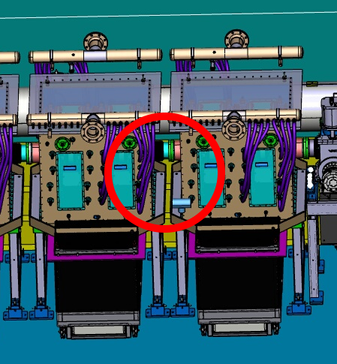
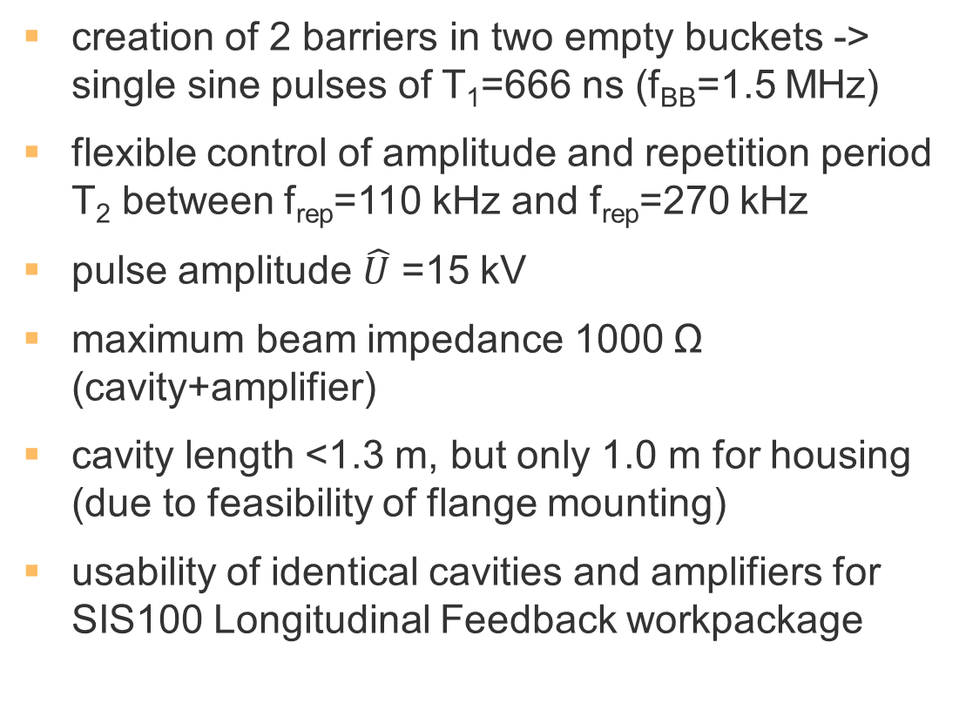
SIS100 requirements
creation of 2 barriers in two empty buckets -> single sine pulses of T₁=666 ns (f_{BB}=1.5 MHz)
flexible control of amplitude and repetition period T₂ between f_{rep}=110 kHz and f_{rep}=270 kHz
pulse amplitude $\hat{U}$ =15 kV
maximum beam impedance 1000 Ω (cavity+amplifier)
cavity length <1.3 m, but only 1.0 m for housing (due to feasibility of flange mounting)
usability of identical cavities and amplifiers for SIS100 Longitudinal Feedback workpackage

Slide 25
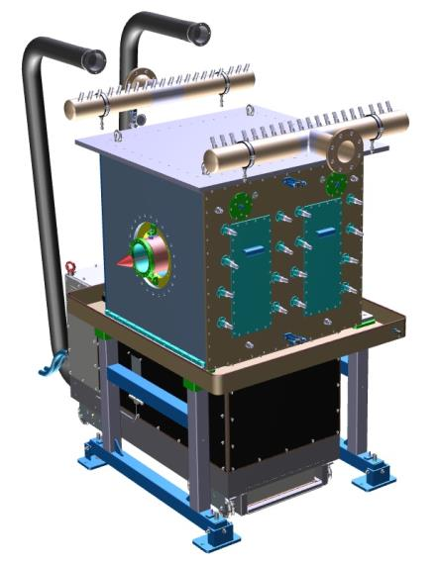
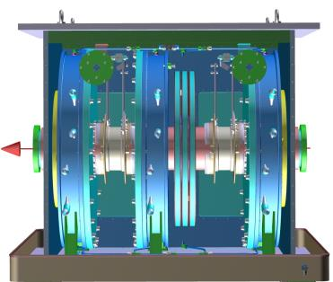
SIS100 BB cavity design
design goals:
broadband behaviour (-> MA cores)
voltage gradient 15 kV/m (MA cores)
matching with tetrode amplifier at tetrode´s working point
cavity´s resonance frequency at or below barrier-bucket frequency f_{BB}
=> very similar to SIS18 h=2 cavity requirements!
working hypothesis:
use h=2 cavity with less MA cores in order to increase resonant frequency
C. Christoph, RRF department, GSI

Slide 26
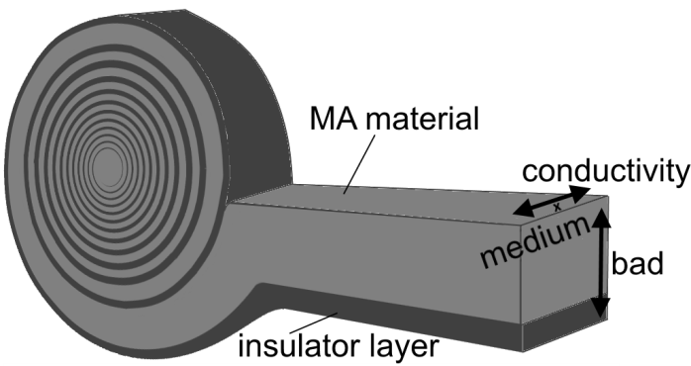
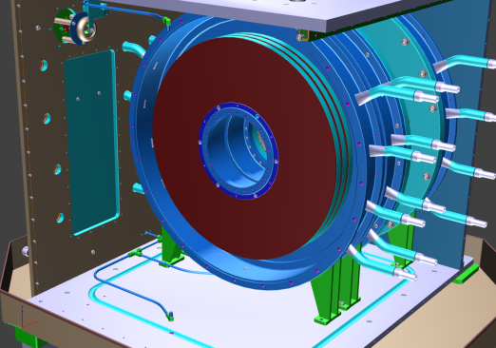
SIS100 BB – oil cooling
due to magnetic loss effects, ring cores heat up during operation
heat conductivity in FT-3M is anisotropic
P. Hülsmann, RRF department, GSI
heat can only be removed through side surface, which is not flat
insufficient heat transfer to cooling disks or air makes direct liquid cooling (oil) necessary

Slide 27
outline
ESR BB system
SIS100 BB system: pre-development phase
requirements
SIS100 BB cavity design
oil cooling
SIS100 BB power amplifier design
SIS100 BB simulation results
frequency domain
time domain
SIS100 BB outlook
strategy:
PSpice simulation of planned SIS100 BB cavity system
comparison with measurements from mock-up of SIS100 BB cavity (with h=2 components)

Slide 28
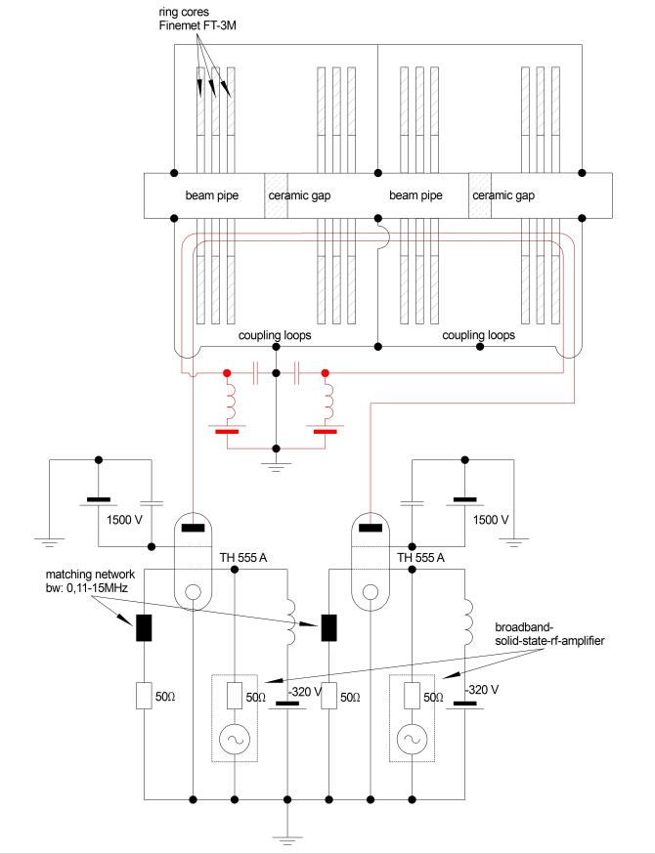
SIS100 BB power amplifier design
required signal quality -> class A amplifier (to avoid distortion in push-pull configuration)
tetrode capable of the expected anode dissipation power at working point above 15 kV -> Thales TH555
compensation of anode currents by opposing winding directions of coupling loops
P. Hülsmann, RRF department, GSI

Slide 29
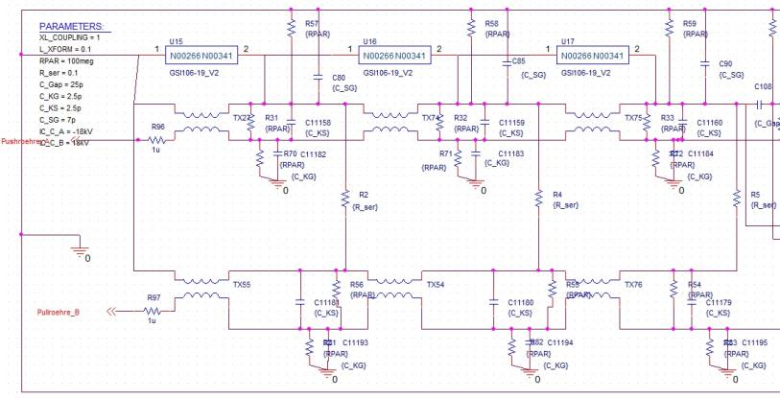
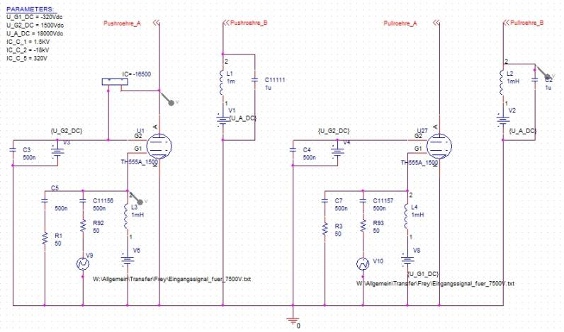
SIS100 BB simulation results – frequency domain
cavity without amplifier (measured at h=2 cavity):
cavity: shown is one of four ring core stacks
power amplifier
tetrode model includes non-linearity
deviations now understood
sufficient matching between cavity and tetrode (R_{i}≈1500Ω)
resonant frequency f_{r}≈1.5 MHz

Slide 30
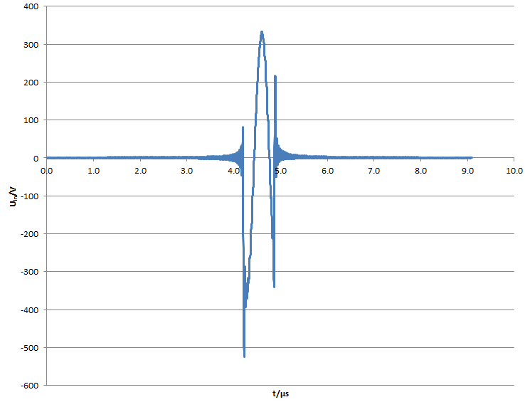
SIS100 BB simulation results – time domain
desired pulse amplitude of 15 kV is achieved (7.5 kV across each gap)
ringing at the pulse´s end is below 5% even with linear pre-distortion
desired bandwidth for input signal transmitting components: from 20 kHz to 30 MHz
input voltage in time domain (linear pre-distortion, 0.02-30 MHz):

Slide 31
SIS100 BB status and outlook
Technical Concept document finished
considerable effort was made to reduce technical risks by investigating (mostly at ARD broadband test cavity):
frequency dependent ring core properties
cavity bandwidth
ring core cooling
frequency- and time-domain simulations of full cavity/amplifier system
impedance reduction by cavity detuning
beam loading (effect of DC-fraction)
signal generation (LLRF system)
Technical Concept proved feasible through all tests (15 kV, <5% ringing expected with non-linear pre-distortion)
Detailed Specification 95% finished
start of procurement is planned for June 2019

Slide 32
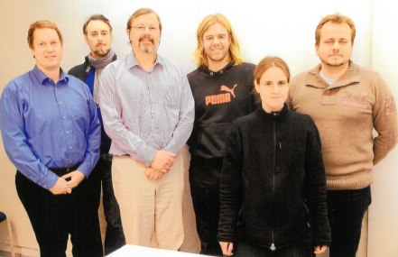
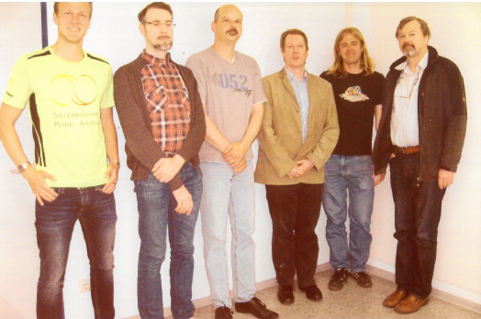
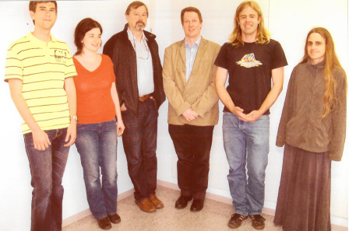
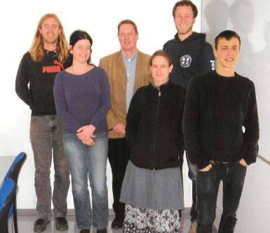
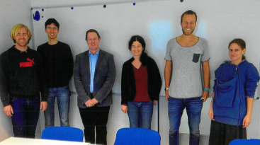

Thanks to all contributors

Slide 33
Development of Barrier Bucket RF Systems for ESR and SIS100
Thank you for your attention
M. Frey, 14. June 2018

Slide 34



Appendix - gap voltage measurement
distortion in measurement chain directly alters gap voltage signal
high effort necessary to reach convenient frequency-response
high impedance part kept as short as possible (reduce reflections)
130 m ½‘‘ Cellflex: 5% distortion
2000 m optical fiber: 2% distortion (but synchronisation with SIS18 not possible yet)

